Slide 1
Lecture 3: Different Database Structures
Dr. Taysir Hassan Abdel Hamid

Slide 2
Hierarchical Structures
The relationships between records form a hierarchical or treelike Structures.
All records are arranged in multilevel Structures consisting of one root record and any number of sub trees levels
All Relationships among records are one -to- many

Slide 3



Course Title
Root
Sub Root
Prerequisite
Date Location
Sub Root
Student
Teacher
Name
Name Grade

Slide 4
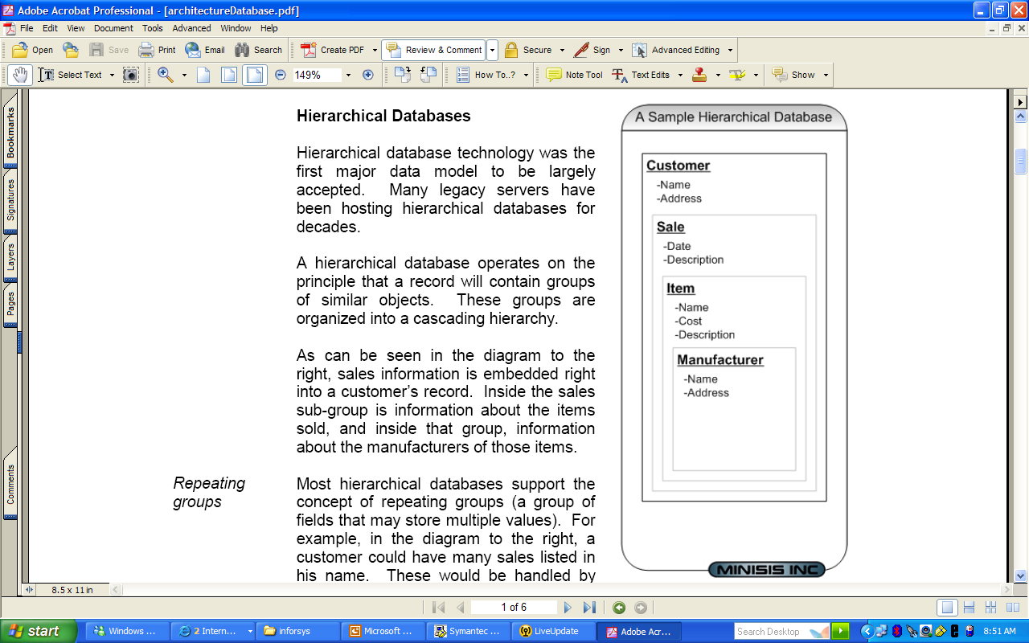

Slide 5
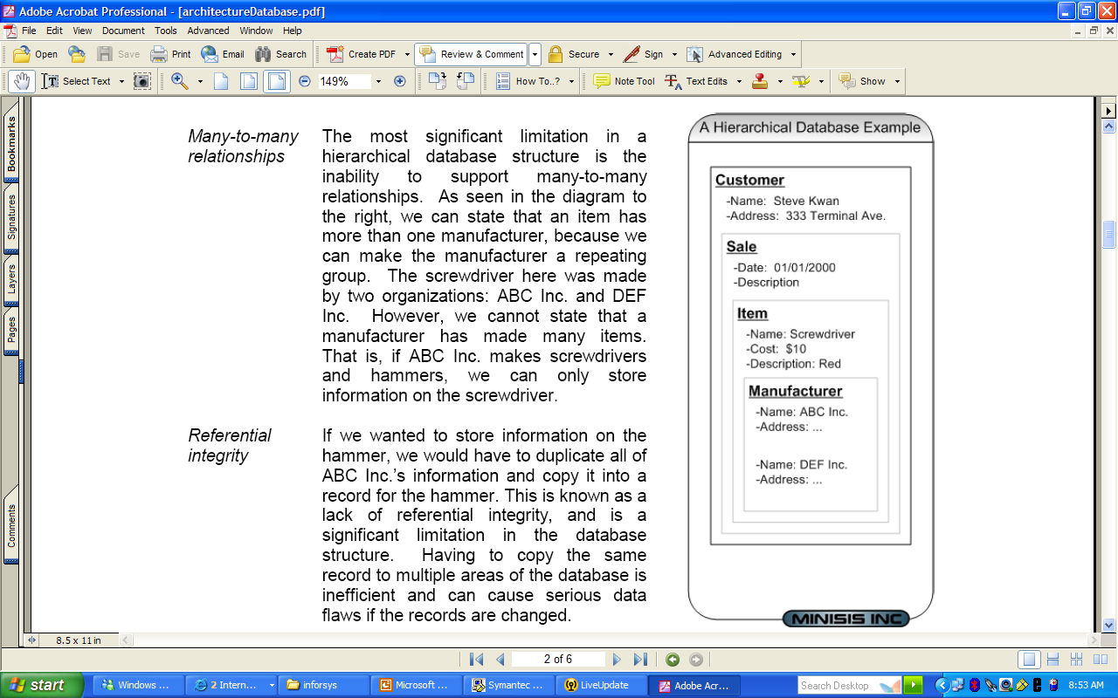

Slide 6
Department
Data Element
Hierarchical Structure
Project A
Data Element
Project B
Data Element
Employee1
Data Element
Employee 2
Data Element

Slide 7
Network Structures
The Network model can access the data element by following one of several paths. Any record can be related to many number of other data elements

Slide 8
Network Structures
Relationships are many-to -many
Record
Supplier(S)
Part(P)
Link S-SP
P-SP
It Consists of two sets
Record Set
Links set
Each link have two kind of records
Quality
SP

Slide 9
Department A
Network Structure
Department B
Employee
1
Employee
2
Employee
3
Project
A
Project
B

Slide 10
Network Structure
Department records can be related to more than one employee record
employee record can be related to more than one project record

Slide 11
Relational Structure
The most popular Structure
All Records stored in the form of tables
Retrieve of data by operator is also in the form of table

Slide 12
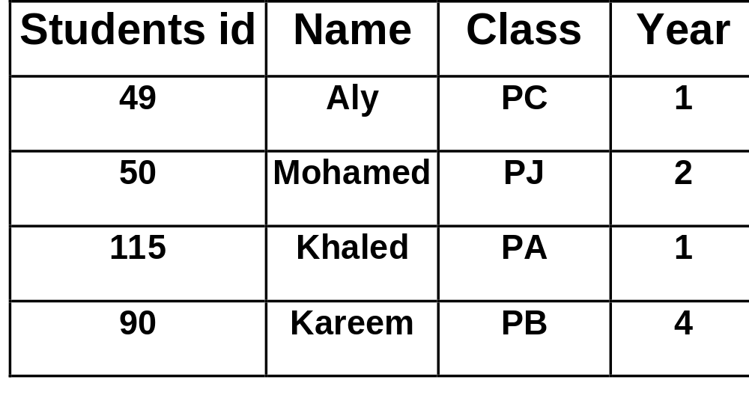
A Given Table

Slide 13
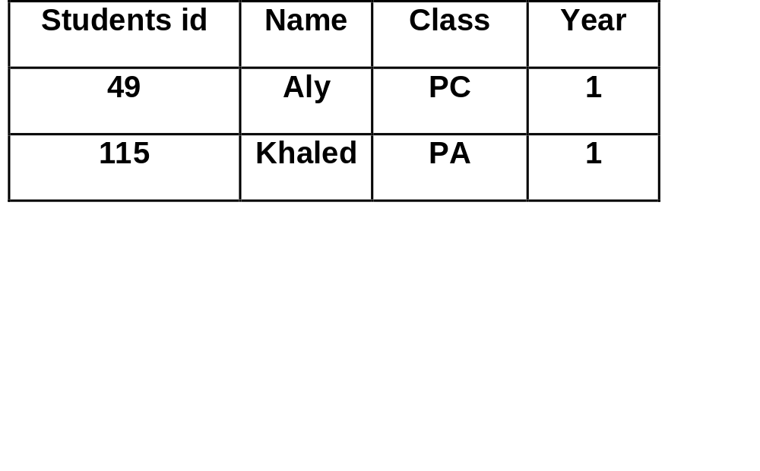
B) Operators
SELECT STUDENT ID,NAME,CLASS,YEAR FROM STUDENT WHERE YEAR=1;
Row Subsets

Slide 14

B) Operators
SELECT Name,YEAR FROM STUDENT WHERE YEAR=1;
Column Subsets

Slide 15
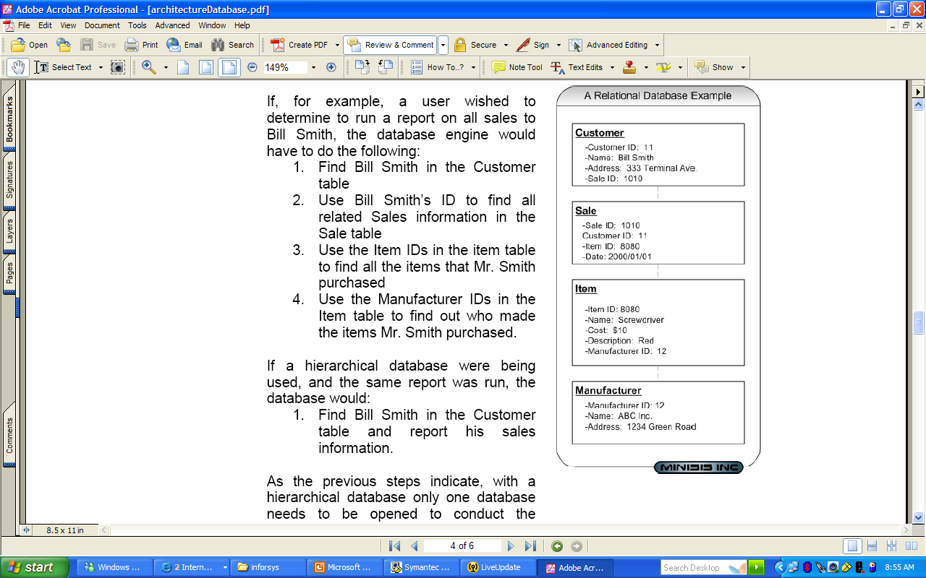

Slide 16
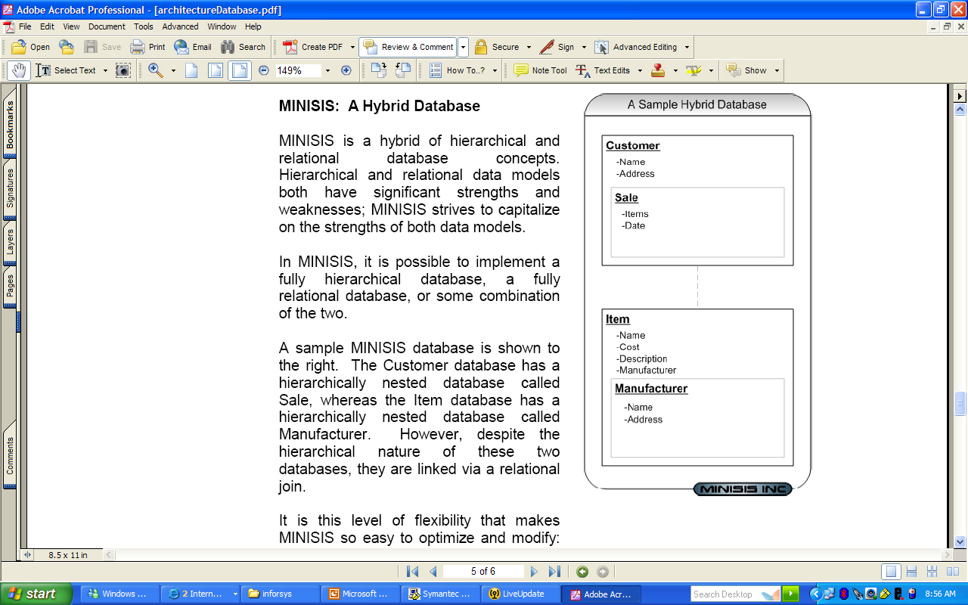

Slide 17
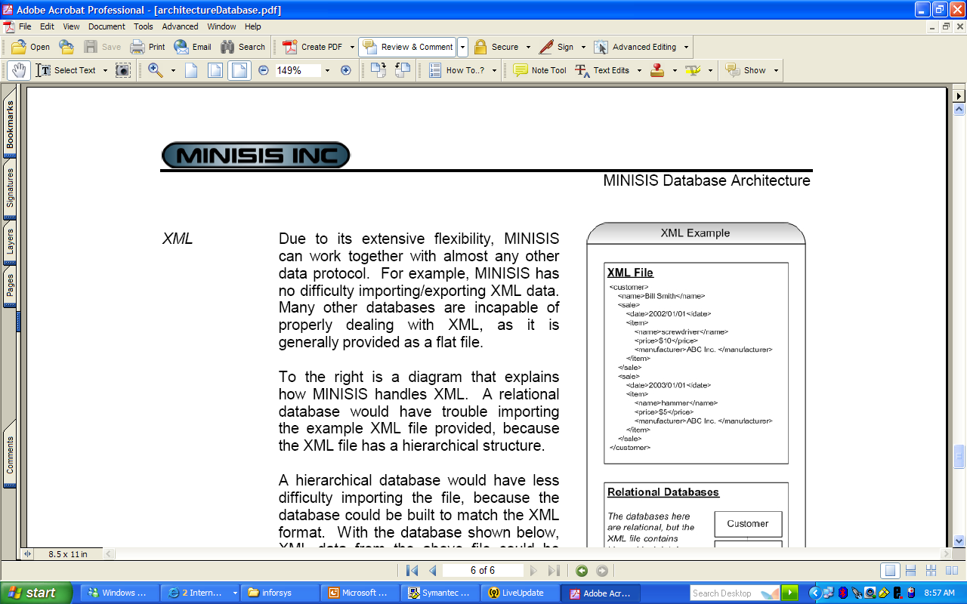
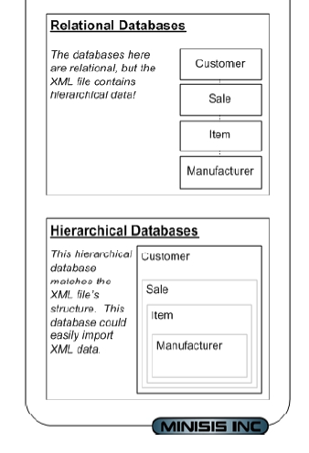

Slide 18
Object-Oriented Structure
This Structure Provide capabilities missing from hierarchical , network, and relational Structures
What is object:An object consists of data and the action that can be performed on the data
Example: Bank Account object consists of data values + the operation performed upon the data

Slide 19
Object-Oriented Structure
(1) Bank Account Object
Attributes
Customer
Balance
Interest Operations
Deposit(amount)
Withdraw(amount)
Get Owner

Slide 20
Object-Oriented Structure
(2)Checking Account Object
Attributes
Credit line
Monthly Statement Operations
Calculate interest owed
Print monthly statement

Slide 21
Object-Oriented Structure
(3)Saving Account Object
Attributes
Number of withdrawals
Quarterly statement Operations
Calculate interest Paid
Print Quarterly statement

Slide 22
Object-Oriented Structure
(1) Bank Account Object
Attributes
Operation
New objects can be automatically created.
Both inherit the common attributes and operations of the parent bank account object.
(2)Checking Account Object
(3)Saving Account Object
Attributes
Operation
Attributes
Operation

Slide 23
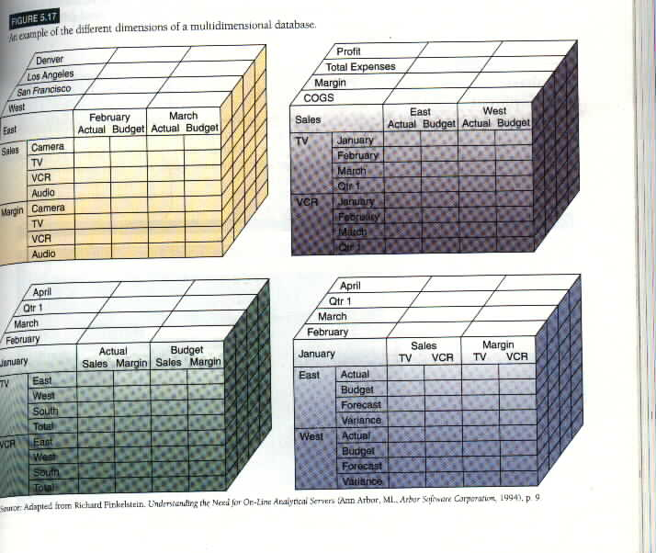
Multidimensional Structure

Slide 24
Multidimensional Structure
Cubes of data and cubes within cubes of data
Each side of the cube is considered a dimension of the data
Each cell contain data related to elements along each dimensions
This structure are compact and easy to understand

Slide 25
Evaluation of Database Structures
The Hierarchical Structures
Is a natural model used for Structured routine types of transaction processing where the data of many operations can be represented in related groups of records (one-To-many)

Slide 26
Evaluation of Database Structures
If the records do not have tree relationships, for example employees from more than one department can work in the one project, in this case the network Structure could handle this many-to-many relationship.

Slide 27
Evaluation of Database Structures
In both structures(Hierarchical and network) the relationships between records must be specified in advance.
For this reason they cannot easily handle ad hoc requests for information

Slide 28
Evaluation of Database Structures
In Relational database structure not all of the Relationships between the data elements need to be specified when the database is created.
So, it allows the end user to easily receive ad hoc request information

Slide 29
Evaluation of Database Structures
Database Software [ORACLE , DB2, Access] create new tables of data relationships using part of data from several tables

Slide 30
Important
Relational database are
-Easier for Programmers
-Easier to work with
-Easier to maintain than the hierarchical and network

Slide 31
But
Cannot Process large amounts of transactions as quickly and efficiently as those based on hierarchical and network types

Slide 32
This performance gap was decreased
by the use of Database Management Software (DBMS)
based on the object-oriented and multidimensional models

Slide 33
Database Development
Large database
Is the responsibility of the:
Small Personal database
1- Database administrator
2- Database designer
3- End users
4- System Analysts
They work together to determine
Microcomputer database Packages
(Microsoft Access)
A-What data definitions should be included in the database
B-What Structure should exist among the data elements.

Slide 34
Developing Database start with top-down data-planning process
Designing
a Database
Changing
a Database
Creating
a Database
Retrieving
Data from
a Database
Entering
Data into
a Database
Generating
Reports from
a Database

Slide 35
1-Data Planning
Develop a model of business
processes
Physical Data Models
Storage representations and
access methods
Enterprise model of business
processes with documentation
5- Physical Design
Determines the Data storage
structures and access
methods
2-Requirements Specification
Define information needs of end
users in a business process
Logical Data Models
e.g. relational,network,
hierarchical,multidimensional,
or object-oriented models
Description of user’s needs may
be represented in natural
language or using the tools of a
particular design methodology.
4- Logical Design
Translates the conceptual
models into the data model of
a DBMS
3-Conceptual design
Expresses all information
requirements in the form of a
high-level model.
Conceptual Data Models
often expressed as entity
relationship models

Slide 36
E-Business Applications
The Internets, Intranets, and Extranets in Business.

Slide 37
E-business
E-business is the use of the Internet technologies to internetwork and empower:
  business process,
  electronic commerce, and
  enterprise communications and collaborations within:
A company and with
  Customers
  Suppliers
  Other business stakeholders

Slide 38
E-business Applications
Telecommunications Networks
Enterprise Communication
And Collaboration
E-Commerce
Internal Business Systems
Electronic Mail
Voice Mail
Discussion Forums
Chat Systems
Data Conferencing
Voice Conferencing
Video Conferencing
Electronic Meeting Systems
Online Point-of-Sale Transaction Processing
Web retailing
Online Auctions
Interactive Marketing
Electronic Funds Transfer
Online Banking
Internal Transaction Processing
Customer Relationship Management
Workflow systems
Activity monitoring

Slide 39
The role of the Internet & Extranet
Companies are deriving business value from the Internet which enables them to disseminate information globally.
As business continue to use open Internet technologies [extranets] to improve communication with customers and partners, for product development, cost savings, and marketing.

Slide 40
The future of Intranets and Extranets
More information and applications will be accessible on the company intranet via an enterprise information portal.
Universal web browser for timely access to business.
Data analysis applications and legacy systems will be front-ended by a company’s enterprise information portal.
The intranet will become the primary vehicle for delivery of employee and company news

Slide 41
Thus,
Members of a team or workgroup do not have to work physically in the same location.
They can be members of a virtual team, whose members are united by the task they are collaborating, not by geography or membership in a larger organization.

Slide 42
Groupware for
Enterprise
Collaboration
Electronic
Communication
Tools
Electronic
Conferencing
Tools
Collaborative
Work
Management
Tools
E-mail
Voice Mail
Faxing
Web Publishing
Internet Phone
Data Conferencing
Voice conferencing
Video Conferencing
Chatting
Calendaring and scheduling
Task and project management
Workflow systems
Document sharing

Slide 43
Thank You

